Slide 2
Xamarin.Forms Mais Produtivo & Bonito Do Que Nunca
Oberdan Ferreira
Chapter Lead @ ArcTouch
Membro do Monkey Nights

Slide 3


Slide 4
How Xamarin Delivers the Awesome
Notes:
Big thank you to contributors. Show growth. Gifts on the way.

Slide 5

.NET
100% APIs das Plataformas
100% Experiência Nativa
90%+ Compartilhamento de código
Tudo isso com .NET
UI Nativa Compartilhada
Lógica Compartilhada

Slide 6
✓ Sempre atualizado
Same-day support:
iOS 5
iOS 6
iOS 7
iOS 8
iOS 9
iOS 10
iOS 11
iOS 12
iOS 13
Suporte a:
iOS Extensions
Apple Watch
Apple TV
Android Wear
Amazon Fire TV
E mais…
Notes:
To top it all off, Xamarin is on top of all the latest OS updates and additional platforms.

Slide 7


Xamarin & Xamarin.Forms ecosystem
Notes:
If there is something not in the box, don’t worry as there is a huge ecosystem around Xamarin and Xamarin.Forms apps.

Slide 8


















Massive Collection of Libraries & Tools
Cognitive
Services
Azure Active
Directory B2C
Zxing
Barcode
Scanning
Akavache
Zeplin
GrialKit
Notes:
First is libraries, essentially giving you anything that you need.

Slide 9
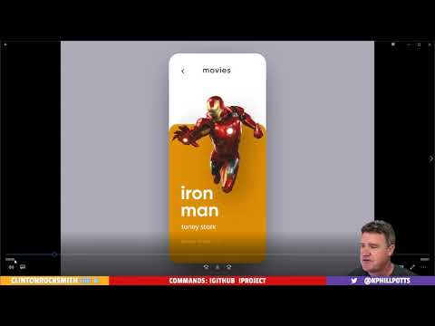


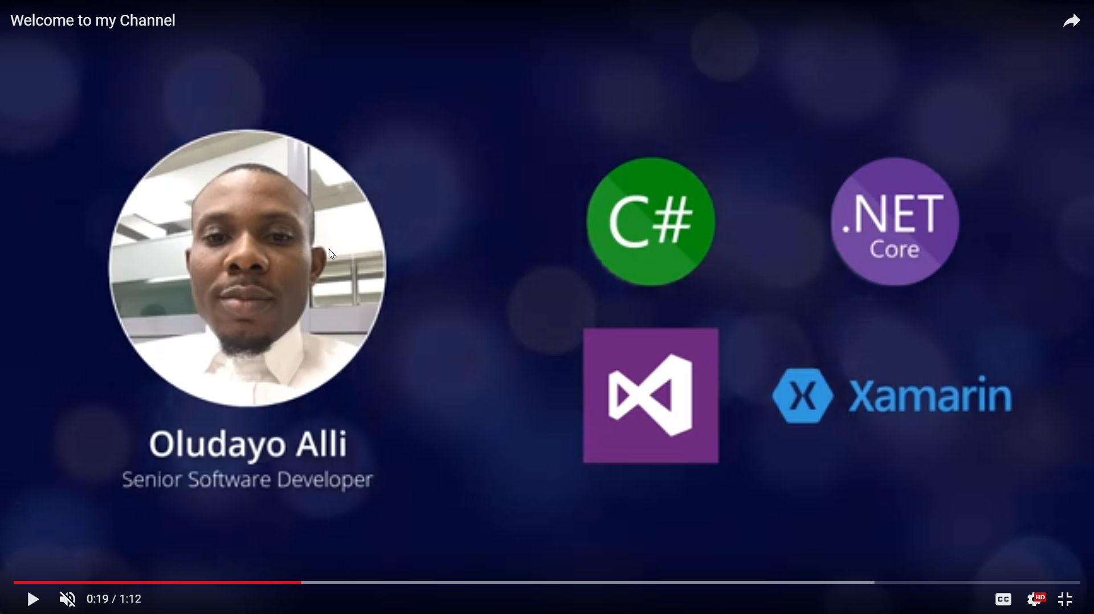
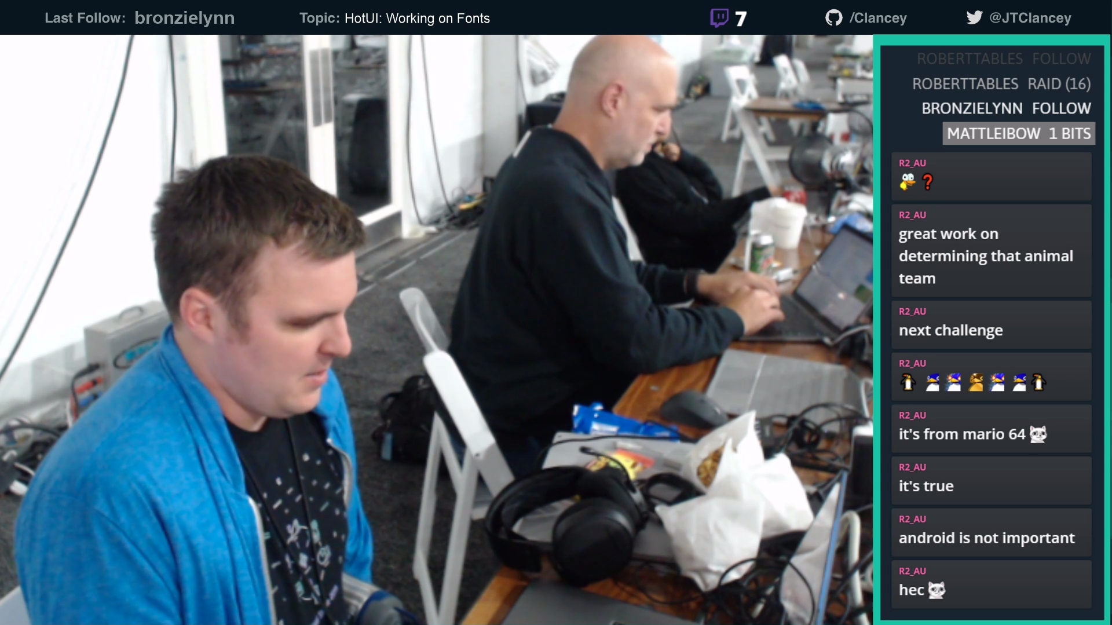




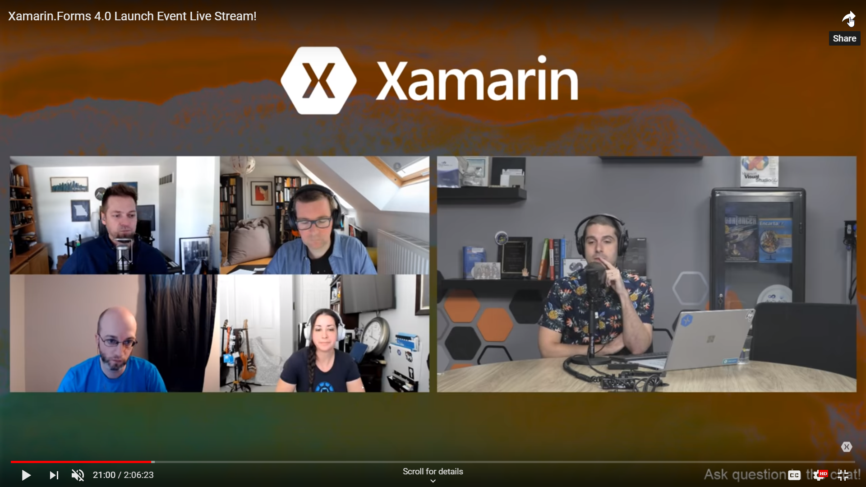

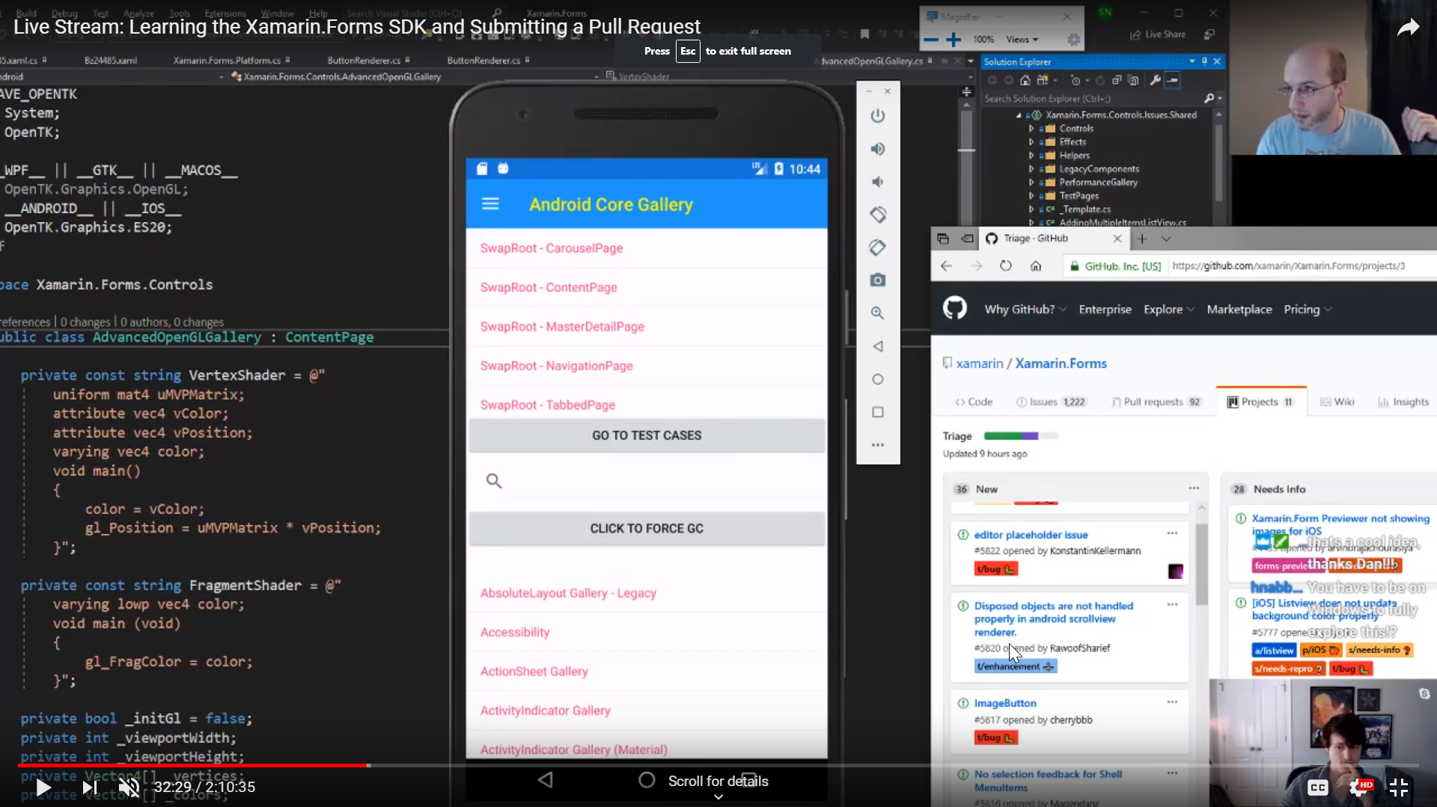
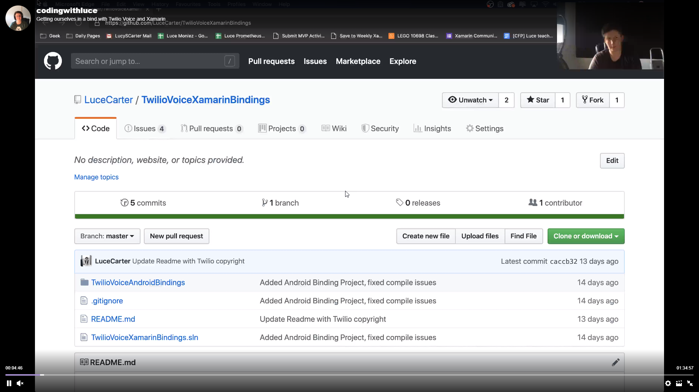

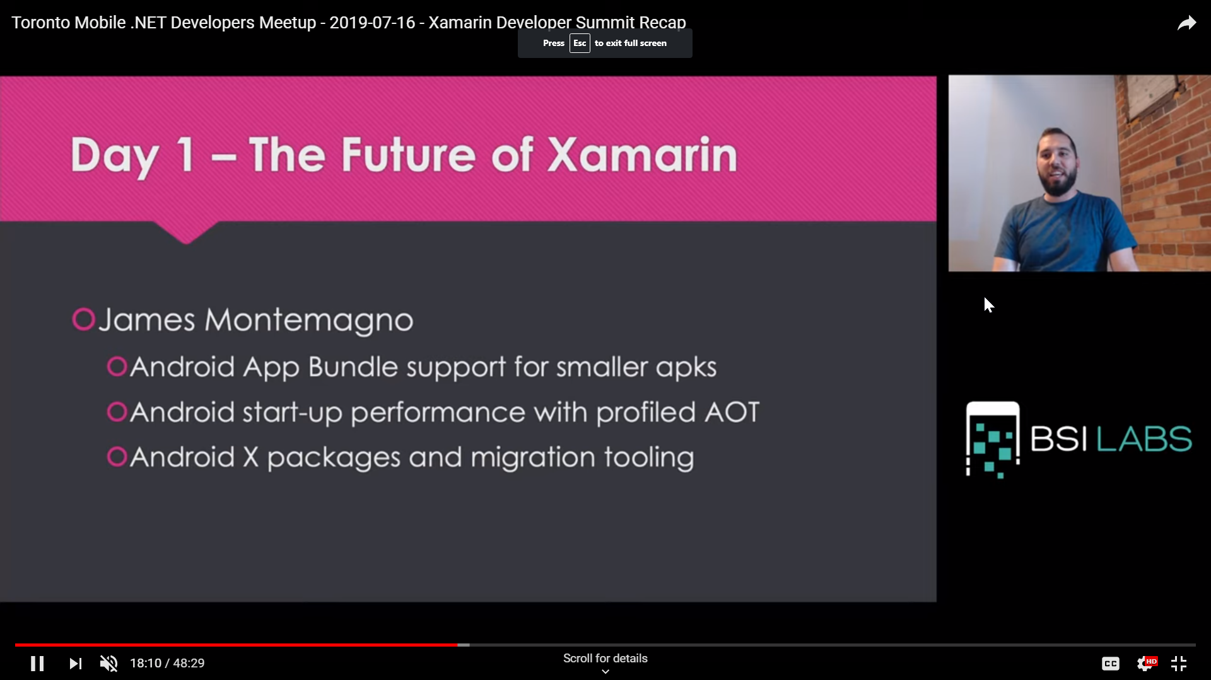
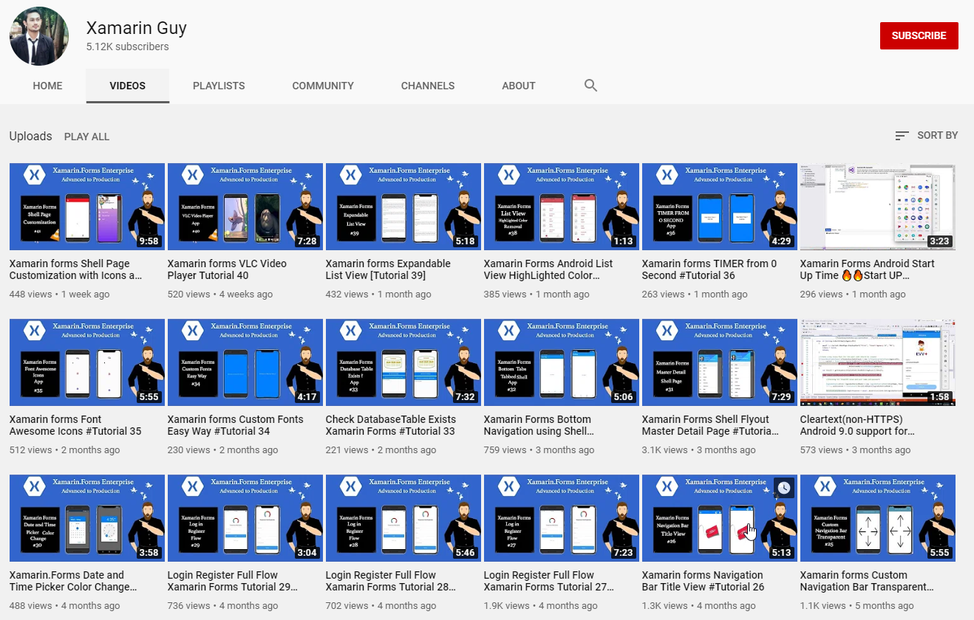

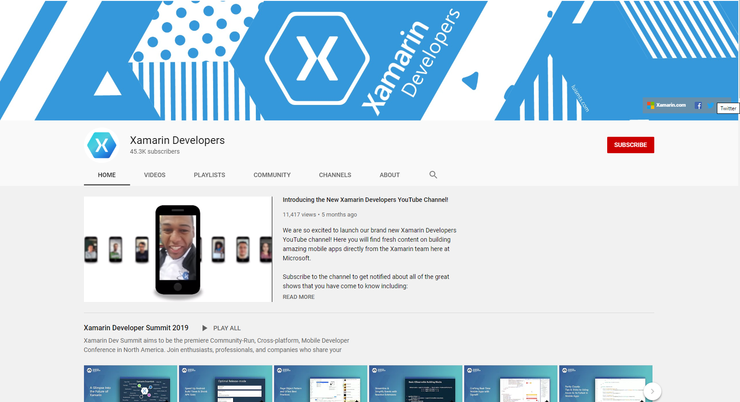
aka.ms/xamstreamers
Notes:
Collage of streamers streaming. Put a list up on aka.ms/xamstreamers
Motz
Clancey
Me
Kym
Glenn
Gerald
Javier
Shane
https://www.youtube.com/channel/UCVwwehJC74qBhMhwFWJkwEQ
https://www.youtube.com/channel/UCBKLE3rLU0CJebTBJ_N4ajQ Xamarin Guy
https://www.twitch.tv/codingwithluce
https://www.youtube.com/c/monkeynights
https://www.pscp.tv/ionixjunior

Slide 10
iOS 13
Dark Mode
iPadOS
Project Catalyst (rodar apps iPadOS no macOS Catalina)
Sign in With Apple
Obrigatório para novos apps
Apps existentes tem até Abril de 2020 para suportar*

Slide 11
Android 10
Dark Theme
Suporte a foldable devices (Surface Duo, Galaxy Fold)
Suporte à navegação por gestos (permite gestos que excedam o tamanho da tela)

Slide 12
XAML Hot Reload
Notes:
Blogs and community challengs

Slide 13
XAML Hot Reload
Anunciado no Xamarin Dev Summit em Julho
Aumenta produtividade
Não é necessário configurar nada no projeto
Sem pacotes nuget
Necessário Xamarin.Forms 4.1 +
Disponível no Visual Studio 2019 v16.3 (ou VS4Mac v8.3)

Slide 14
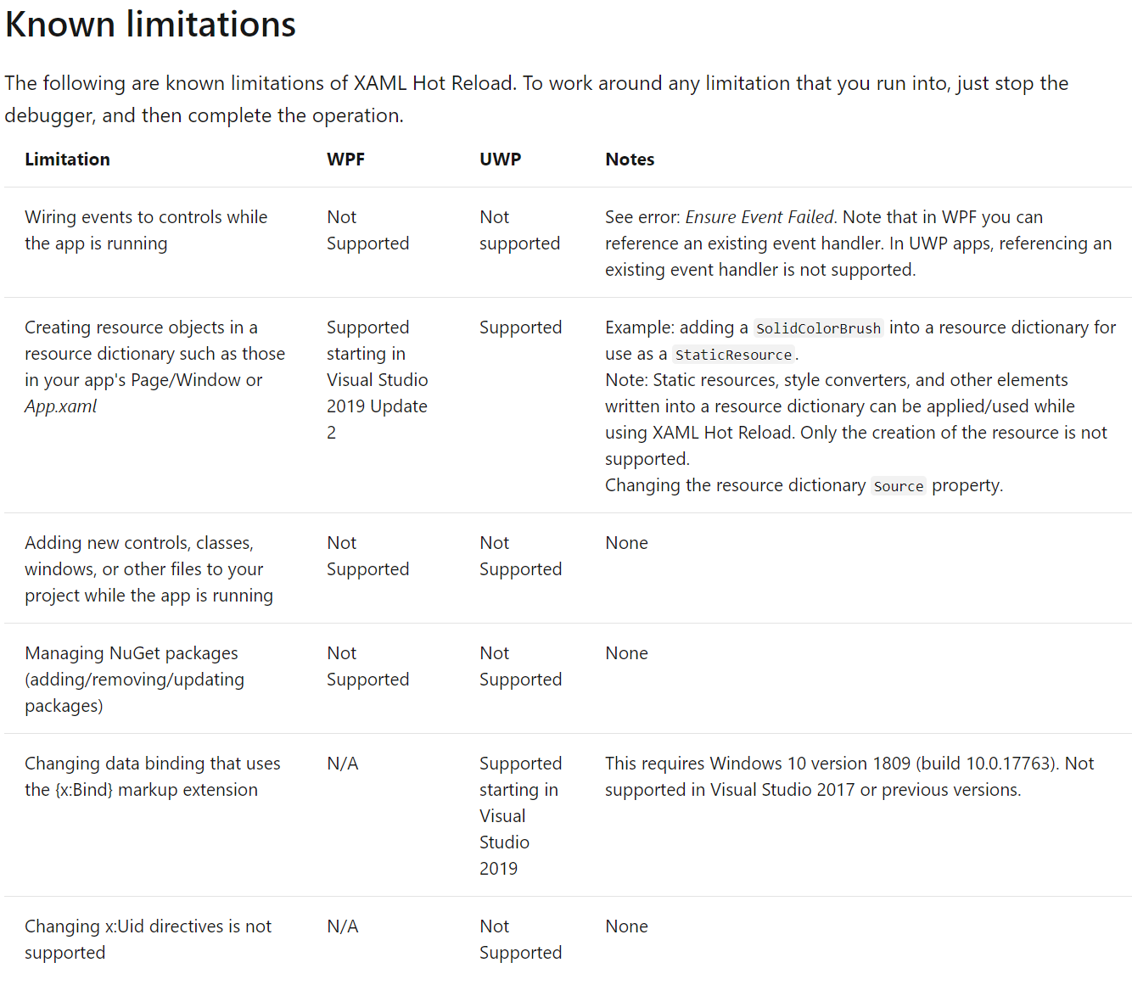

Slide 15
XAML Hot Restart
Notes:
Blogs and community challengs

Slide 16
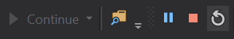
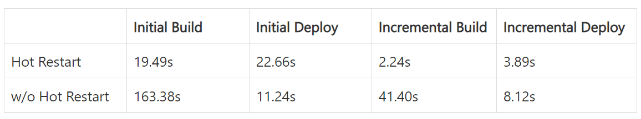
XAML Hot Restart
Anunciado no dotNetConf 2019
Aumenta produtividade
Envia alterações ao app em debug
Suporta mudanças de código, resources e referências

Slide 17
https://aka.ms/xamarin-hotrestart
Notes:
Blogs and community challengs

Slide 18
Xamarin.Forms
Notes:
Blogs and community challengs

Slide 19
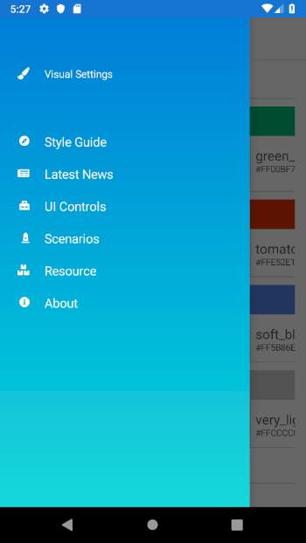
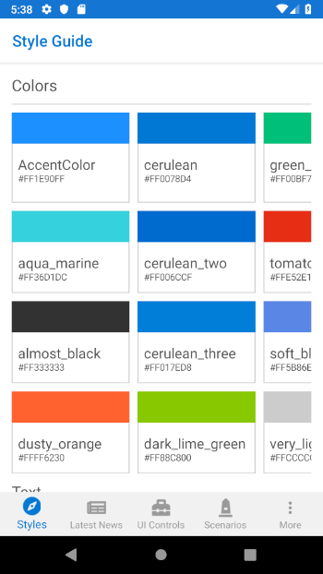
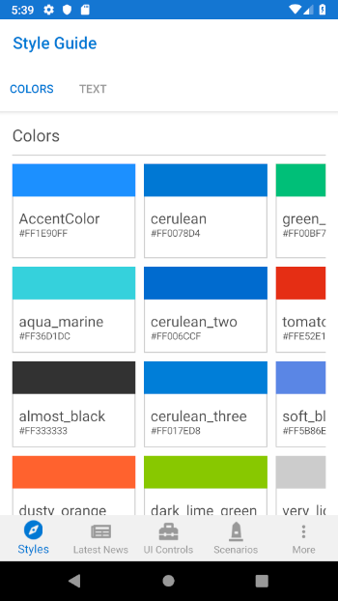
Shell
Notes:
It all starts here with the quickest and easiest way to setup your application.

Slide 20
<Shell>
<FlyoutItem
Title="Style Guide"
Icon="Compass.png">
<ShellContent
ContentTemplate="{DataTemplate p:StyleGuidePage}"/>
</FlyoutItem>
</Shell>
Shell
Notes:
It all starts here with the quickest and easiest way to setup your application.

Slide 21
<Shell>
<TabBar>
<Tab
Title="Styles"
Icon="Compass.png">
<ShellContent
ContentTemplate="{DataTemplate
p:StyleGuidePage}"/>
</Tab>
</TabBar>
</Shell>
Shell
Notes:
It all starts here with the quickest and easiest way to setup your application.

Slide 22
<Shell>
<TabBar>
<Tab
Title="Style Guide"
Icon="Compass.png">
<ShellContent
Title="Colors"
ContentTemplate="{DataTemplate p:ColorsPage}"/>
<ShellContent
Title="Text"
ContentTemplate="{DataTemplate p:TextPage}"/>
</Tab>
</TabBar>
</Shell>
Shell
Notes:
It all starts here with the quickest and easiest way to setup your application.

Slide 23
CityListPage
CityDetailPage
Shell.Current
.GoToAsync($"detail?id={city.id}");
Shell Navigation Service
Notes:
It all starts here with the quickest and easiest way to setup your application.

Slide 24
CityListPage
CityDetailPage
[QueryProperty("CityId", "id")]
public partial class CityDetailPage : ContentPage
{
public CityDetailPage()
{
InitializeComponent();
}
public string CityId
{
set
{
// do something with the Id
}
}
}
Shell Navigation Service
Notes:
It all starts here with the quickest and easiest way to setup your application.

Slide 25
Xamarin.Forms 4.3
Notes:
Blogs and community challengs

Slide 26
Xamarin.Forms 4.3
CollectionView
RefreshView
SourceLink Support
Mostrar HTML em Labels sem custom renderer
CarouselView*
Suporte para Shell no UWP (preview)
Entre outros: https://docs.microsoft.com/en-us/xamarin/xamarin-forms/release-notes/4.3/4.3.0

Slide 27
Demo do Shell
Notes:
Glenn "Because you don't need any other weather than Redmond" O-really?

Slide 28
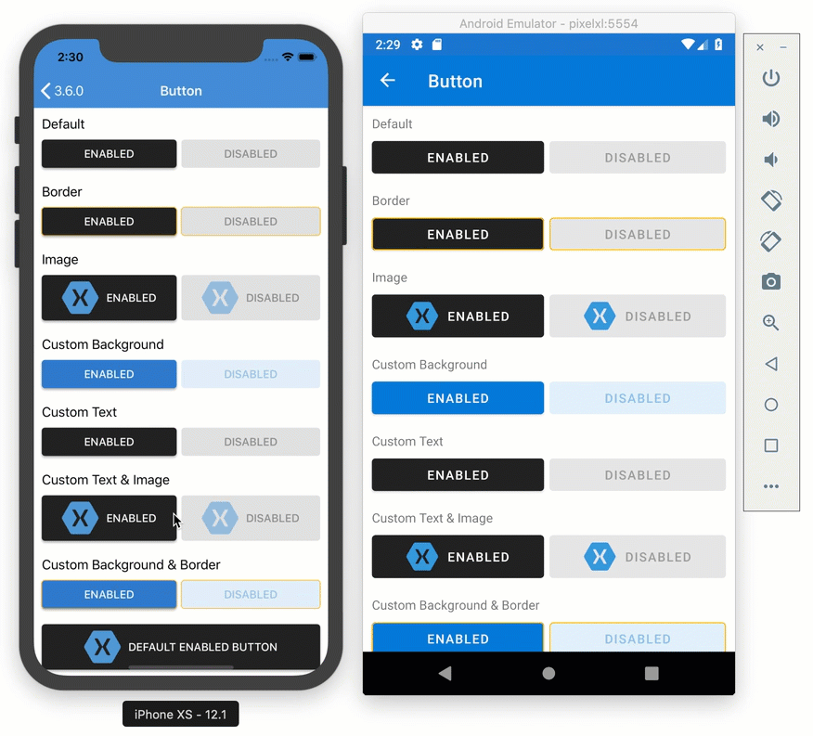
Conjunto de renderers
Aderentes a um design system
Somente Material Design (até então)
ActivityIndicator
Button
Editor
Entry
Frame
Picker
ProgressBar
Slider
Stepper
<Button Text="Consistent Design"
Visual="Material"/>
Visual
Notes:
Looking for consistent UI but retaining platform idioms? Material controls for Visual.

Slide 29
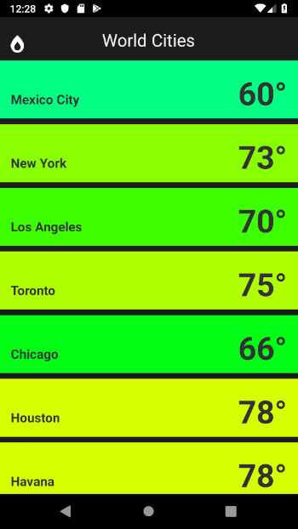
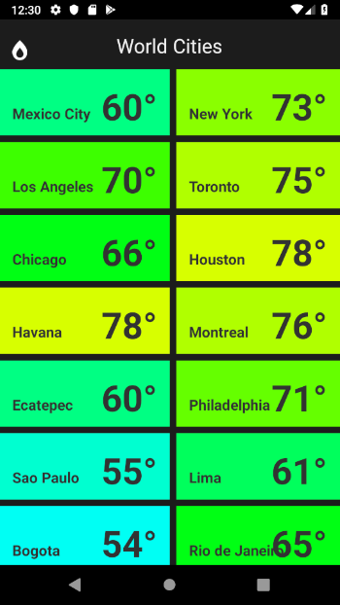
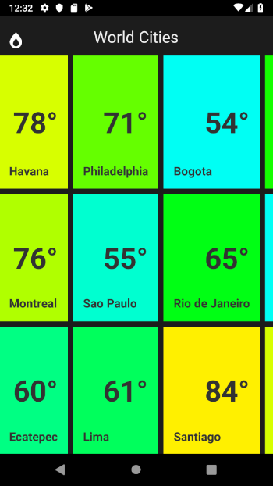
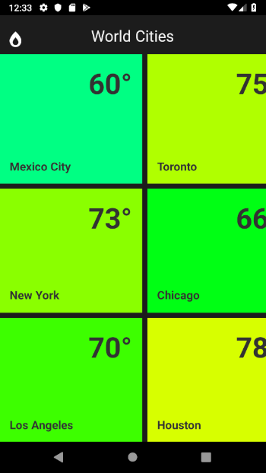
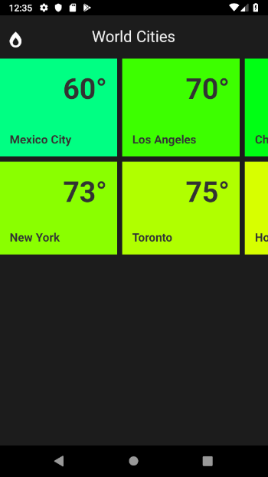
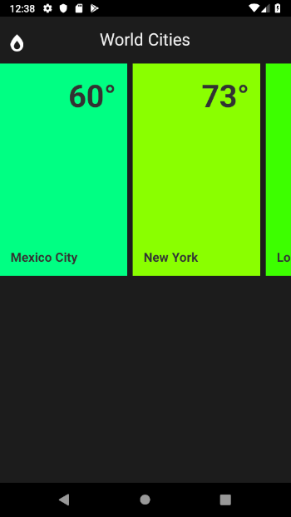
CollectionView
Notes:
Animations of a bunch of layouts
Basic list vertical
Basic list horizontal
Grid 2-3 up
Grouped List vertical
Grouped list vertical with horizontal
Staggered list – custom layout

Slide 30
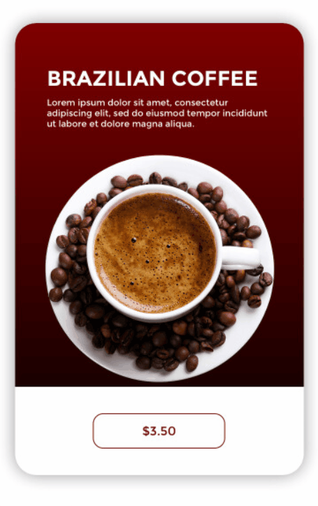
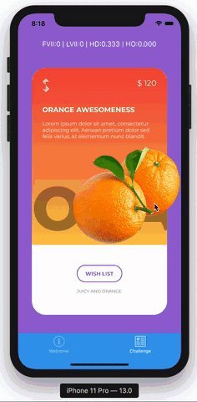

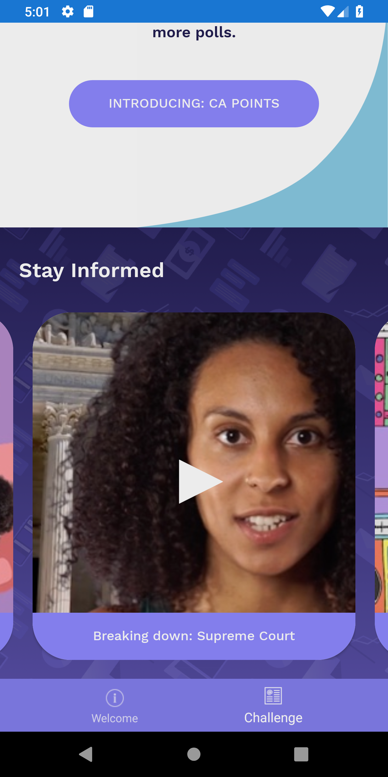
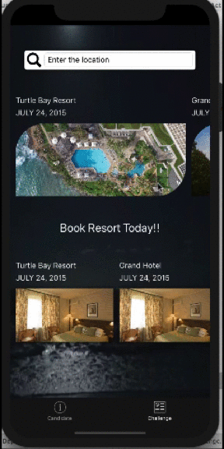
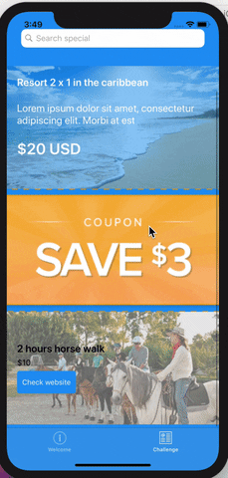
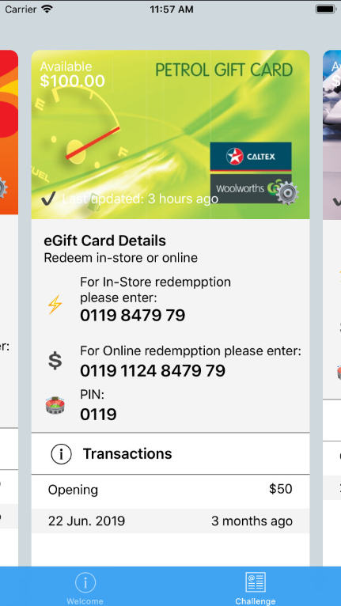
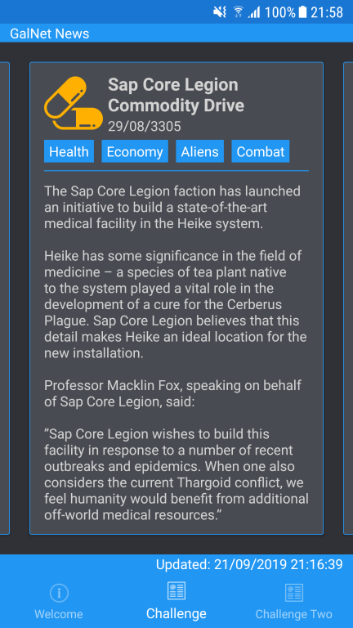
CarouselView
Notes:
Animations of a bunch of layouts
Basic list vertical
Basic list horizontal
Grid 2-3 up
Grouped List vertical
Grouped list vertical with horizontal
Staggered list – custom layout

Slide 31
Demo CarouselView e CollectionView
Notes:
Glenn "Because you don't need any other weather than Redmond" O-really?

Slide 32
Perguntas?
@OberdanFerreira
mkn.dev
arctouch.com/careers

